Slide 1
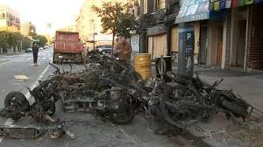
LITHIUM BATTERIES 🔋
A NEW TYPE OF FIRE🔥.

Slide 2
Scooter Fire / News Link on Fire Early 2023
https://www.youtube.com/watch?v=IAAxeXhmQuE&pp=ygUnbGlwbyBiYXR0ZXJ5IG
https://youtu.be/JNjnAHUdoVY
https://youtu.be/yRPW8zN_c0E

Slide 3
The Battery
A lithium-ion or Li-ion battery is a type of rechargeable battery which uses the reversible reduction of lithium ions to store energy. The anode (negative electrode) of a conventional lithium-ion cell is typically graphite made from carbon.
The cathode (positive electrode) is typically a metal oxide. They have a separator between them which if it fails creates issues. Newer batteries have smaller separators to make room for for ions.
They can be small as in a cell phone or as large as a truck, even a train in the future.

Slide 4
The Battery
A battery pack consists of many of these connected batteries, even 100s
Damaged batteries off-gas hydrogen fluoride, which can kill you, burn you, burn your lungs if you inhale it, and even explode. It's a flamable gas cloud.

Slide 5
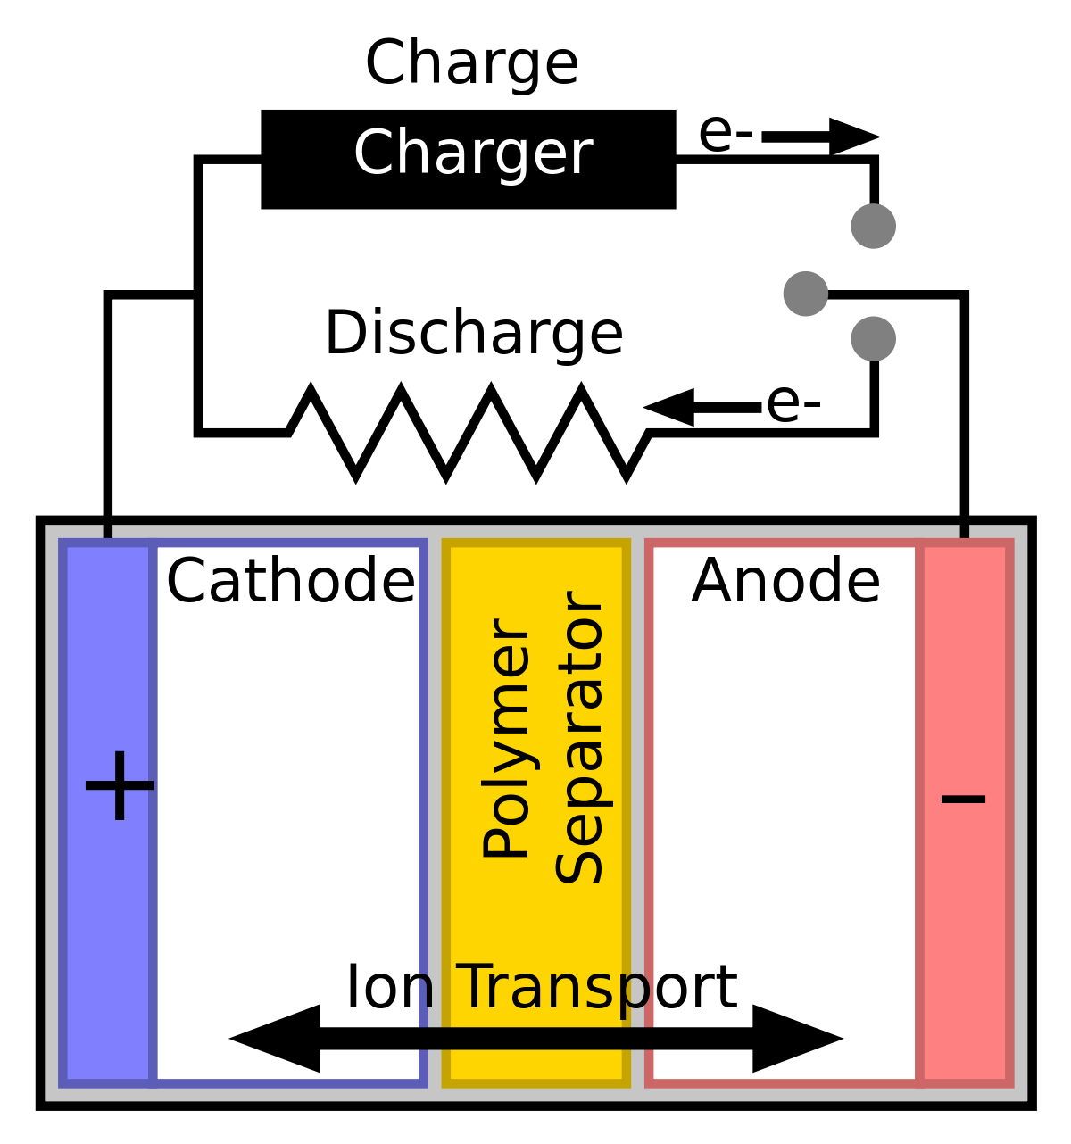
The Battery

Slide 6
Fire Information
Burn hotter then Class A and B fires. Temperatures can exceed 3000 degrees.
Once extinguished expect the fire to rekindle multiple times, possibly even days later until the energy has depleted. Stranded Energy has to be stabilized or denergized.
The term stranded energy refers energy remaining in the cell after the efforts to safely discharge the stored energy in a damaged Lithium Cell.

Slide 7
Fire Information
Burns hotter then Class A and B fires. Temperature can reach close to 3000 degrees.
Once extinguished expect it to rekindle multiple times, possibly even days later until the energy has deplete. Stranded Energy has to be stable or denergized.
The term Stranded energy refers energy remaining in the cell after the efforts to safely discharge the stored energy in a damaged Lithium Cell.
Can cause collapse from excessive heat. Read your structure. Risk vs benefits

Slide 8
Fire Information
Thermal runaway - Thermal runaway describes a process that is accelerated by increased temperature, in turn releasing energy that further increases temperature. If the battery is heating faster then it can cool it will eventually erupt on fire. Might or might not have an incipient phase. Only indication of this process could be off gassing.
The smoke should be assumed to be a flamable gas. In perspective the gas can behave like propane. It can explode or ignite without warning.
Never approach this type of fire without SCBA. Gas is explosive and Highly Toxic

Slide 9
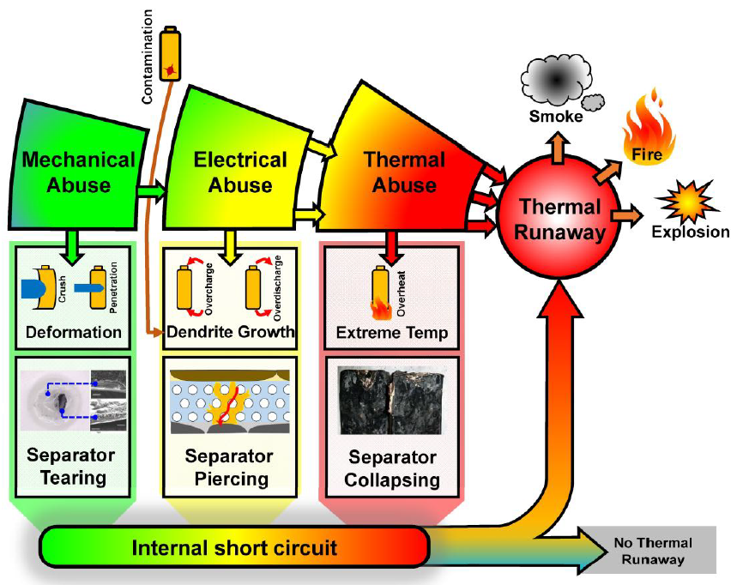
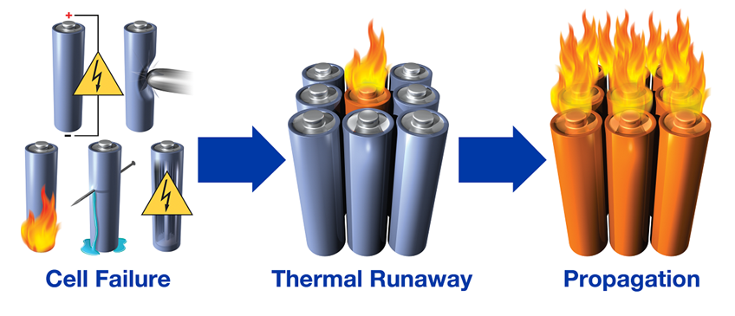
How it Happens

Slide 10
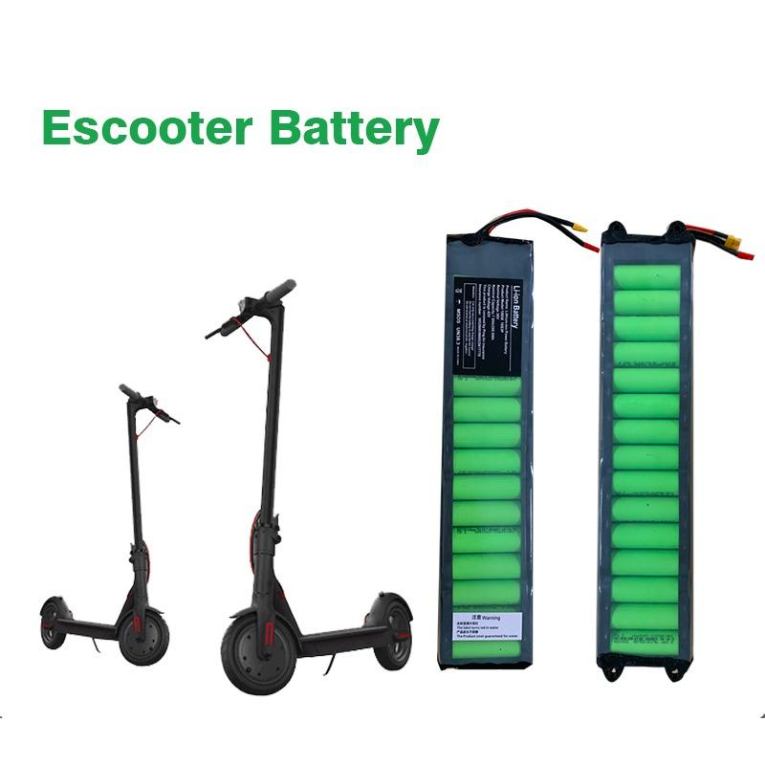
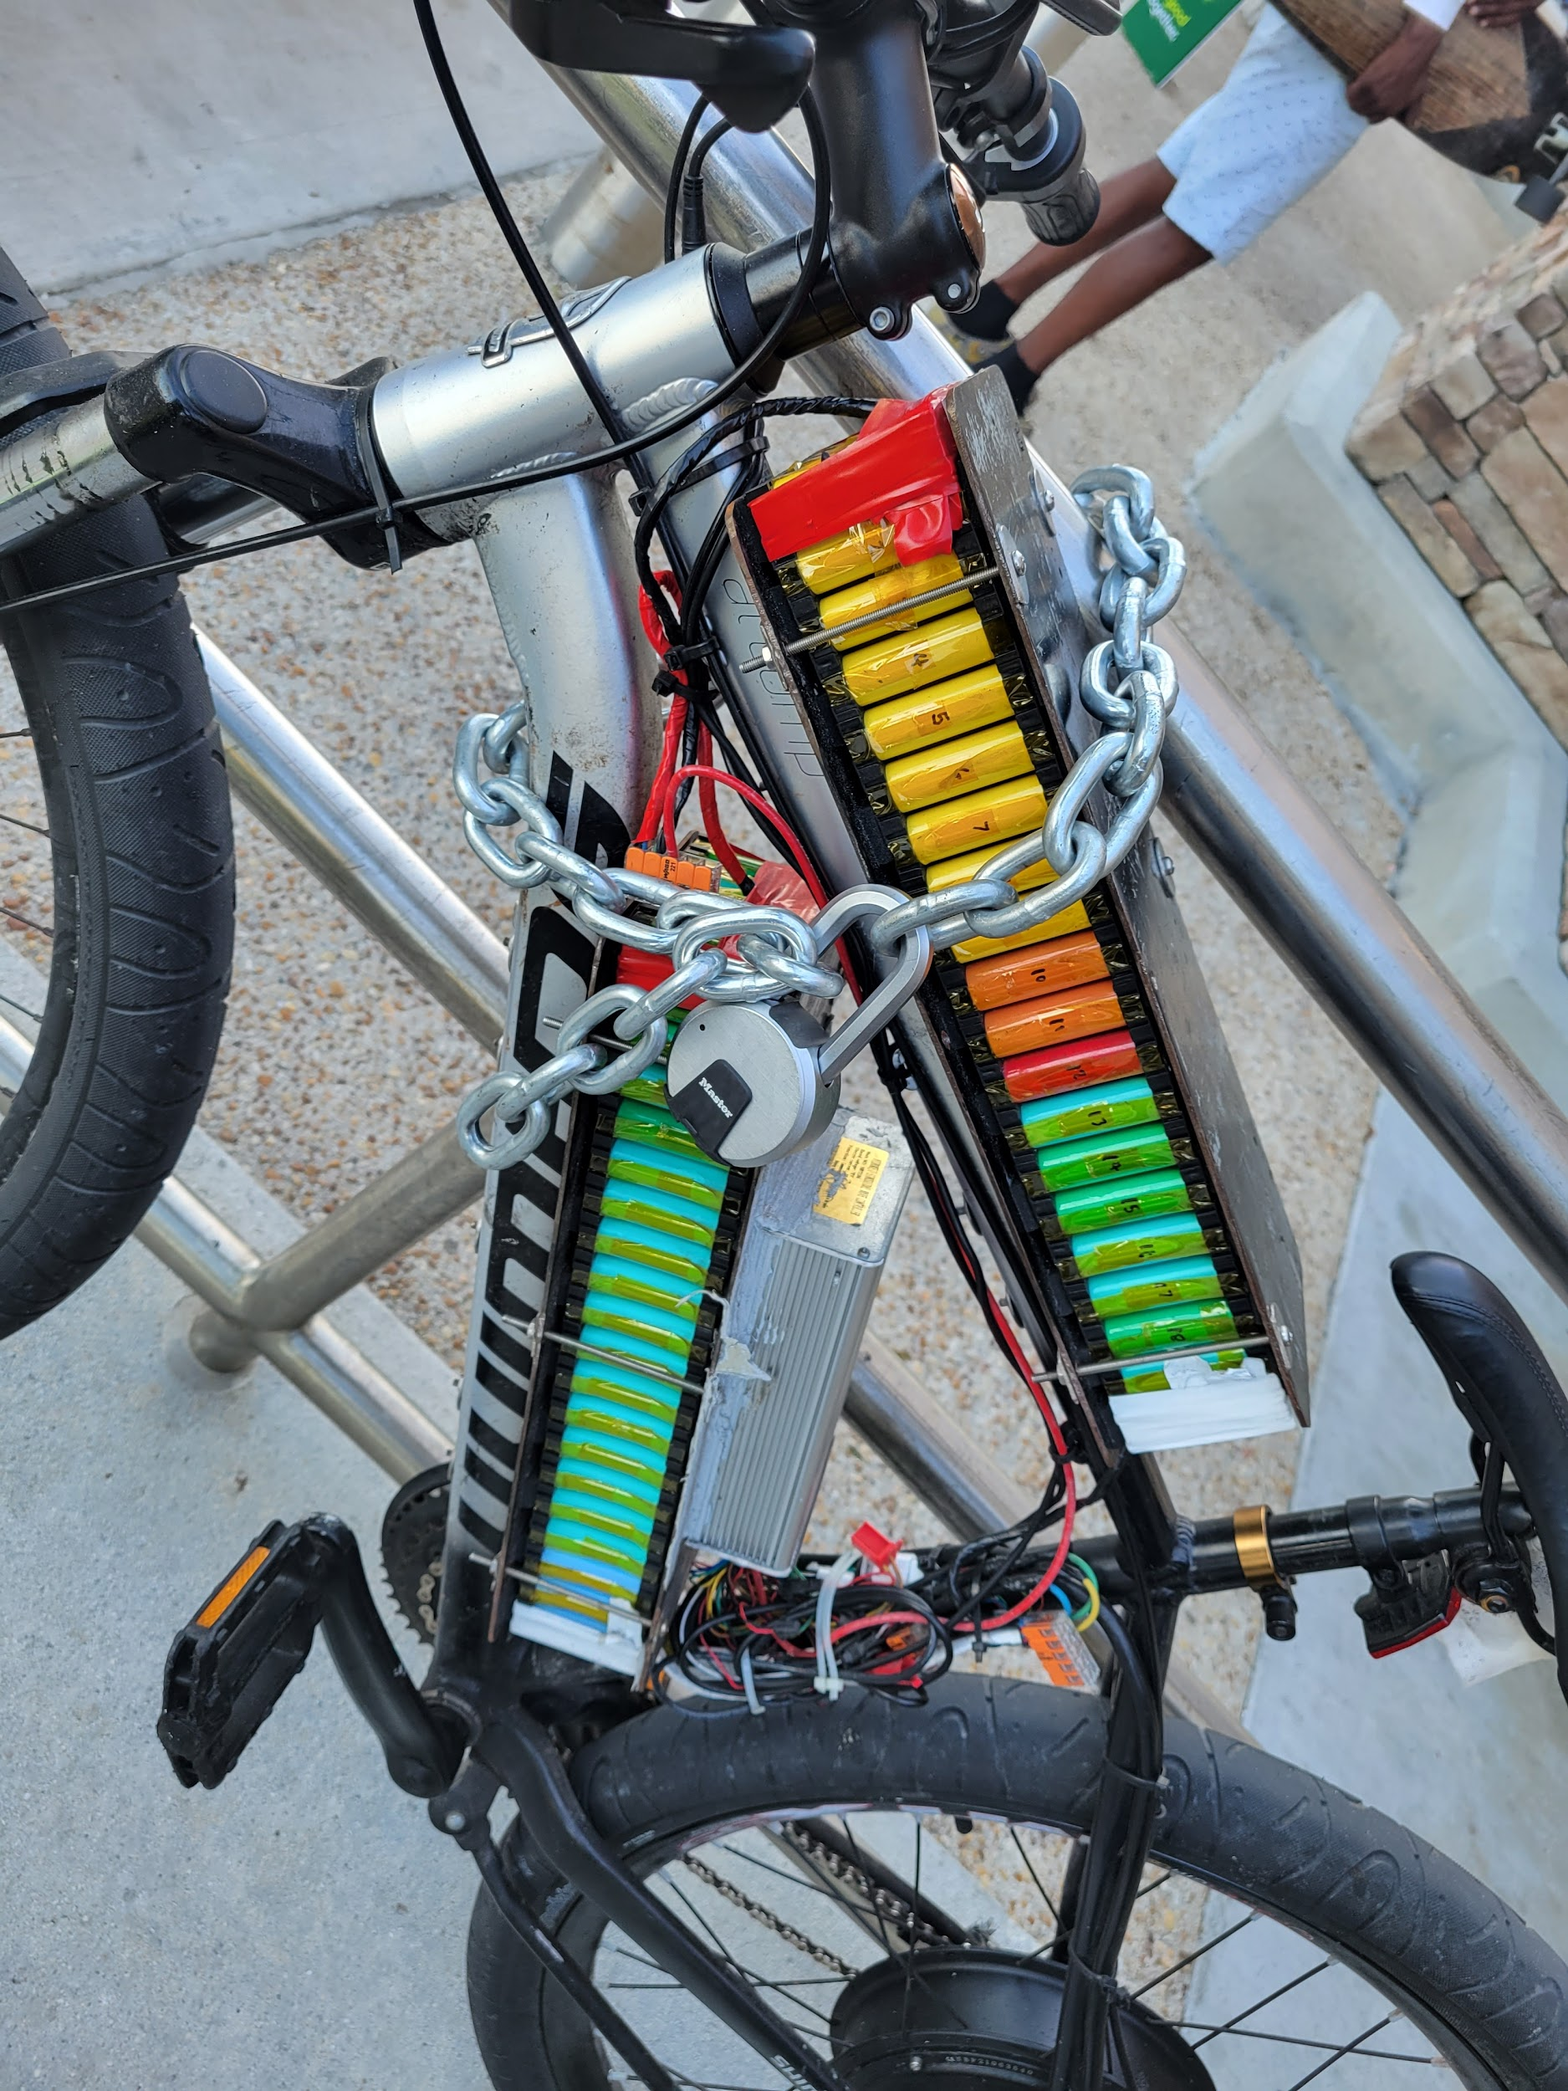
Retail and Do it Yourself

Slide 11
Why it Happens
The energy in these batteries is stable when used properly. Sources that can create issues with the batteries are:
Age of battery
Non UL certified
Most are safe and failure rates are low. Some studies say < 3 in a million
The number of charges (>500) can make the battery unstable.

Slide 12
Why it Happens
The energy in these batteries is stable when used properly. Sources that can create issues with the batteries are:
Not the right charger. Charging to fast to cool. Rapid Chargers not designed for the specific battery.
Damage to the battery. Ie. Scooters being jumped off curbs. Improper use
Water getting in the battery. Batteries should be sealed, moisture can find way in.
Stored in tempertaure either to hot or cold.

Slide 13
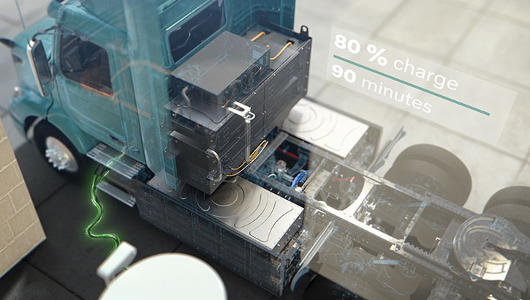
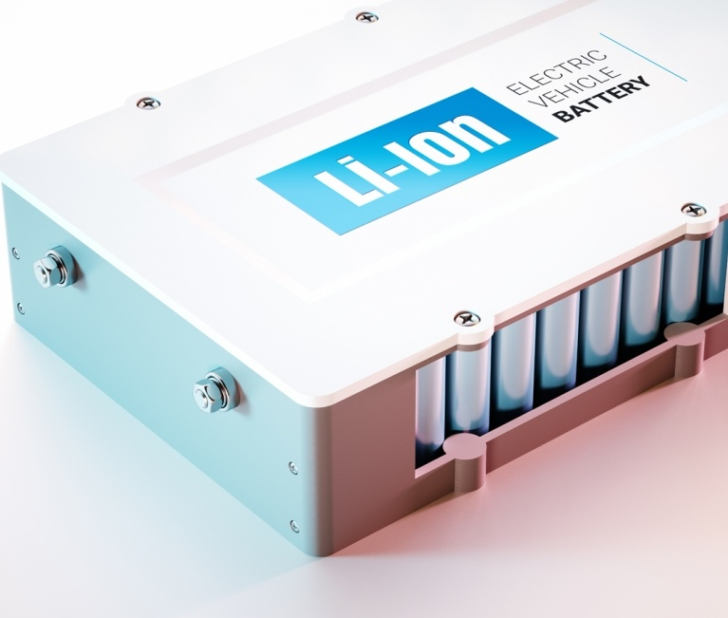
Larger Use

Slide 14
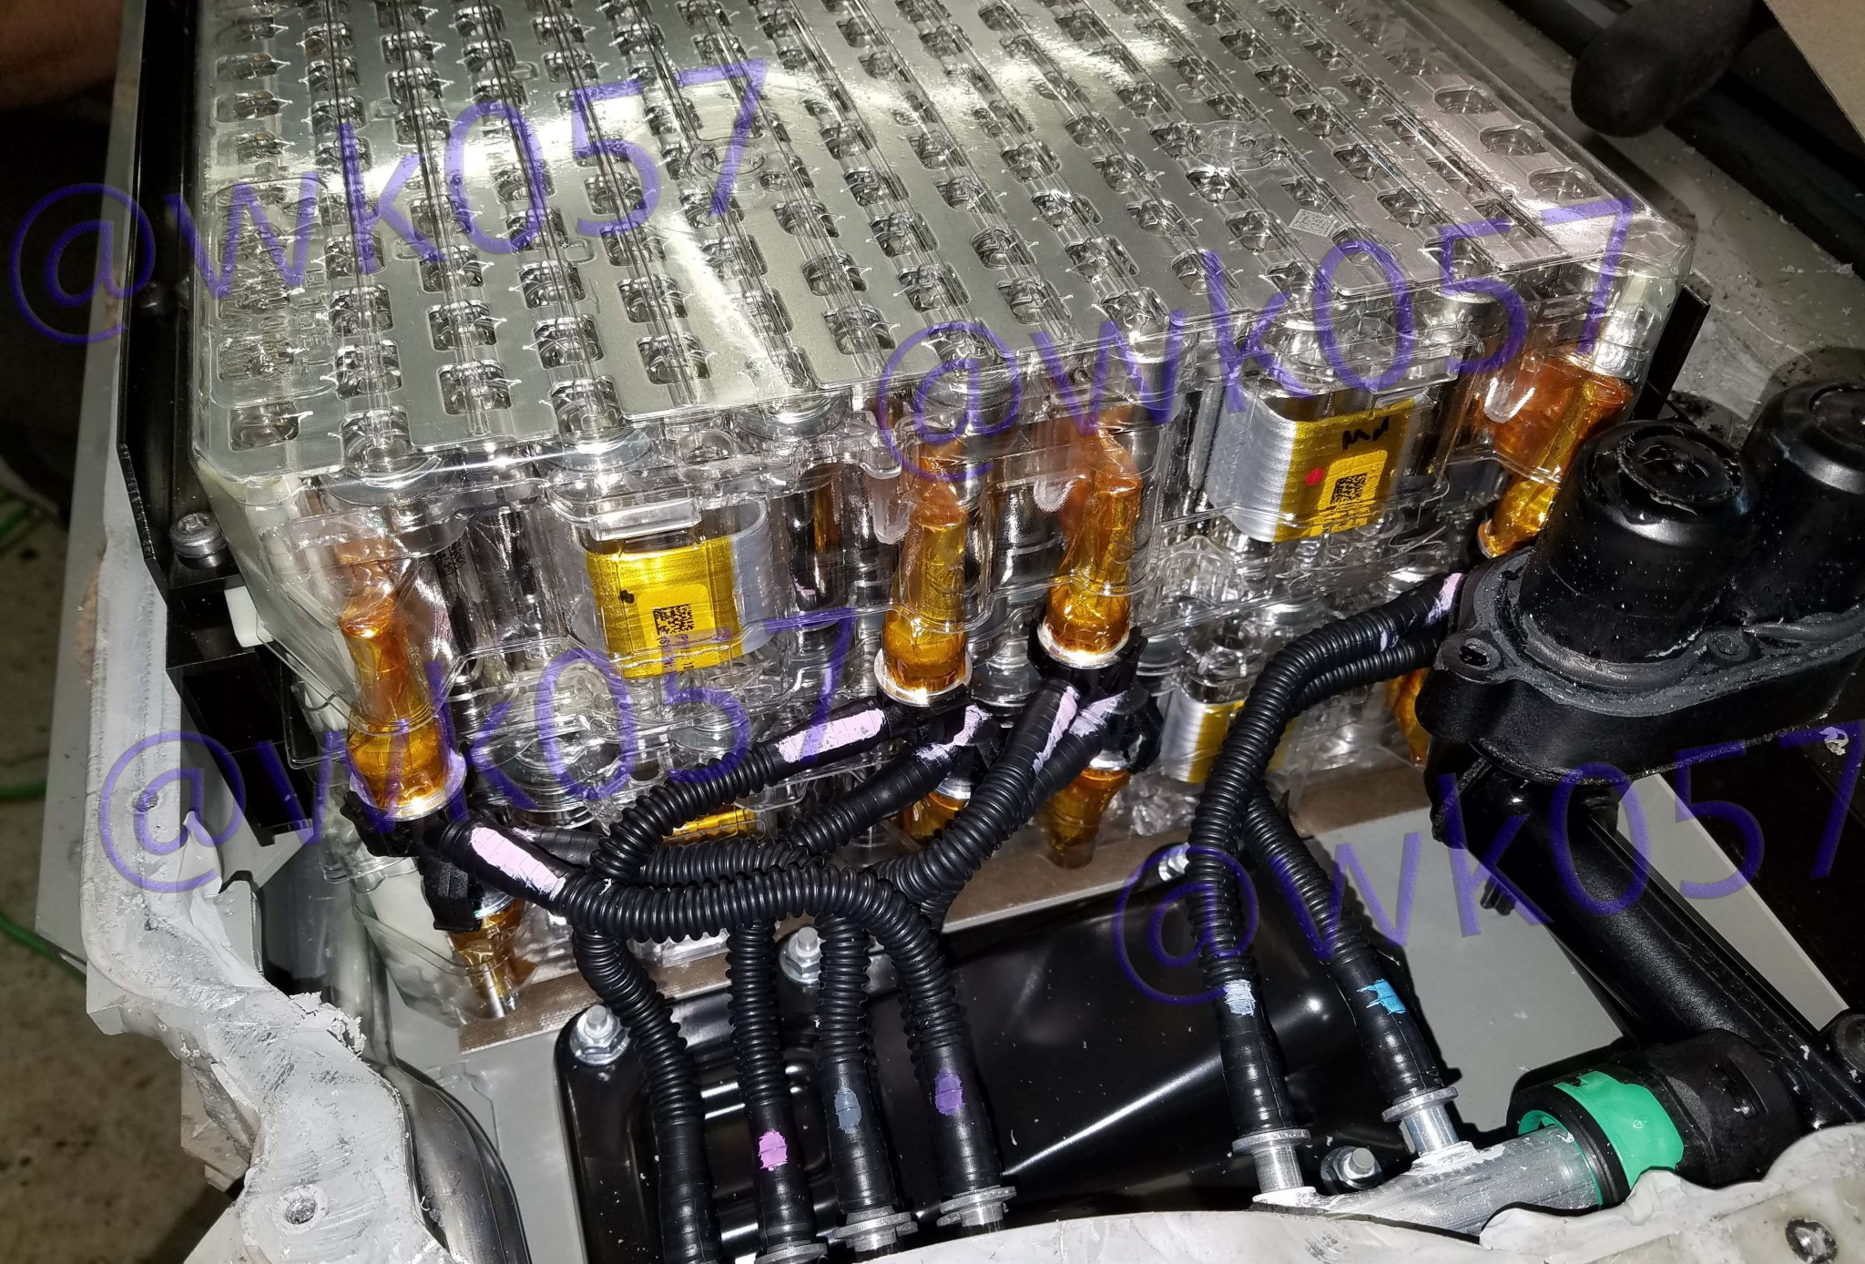
EV (Tesla) Battery Pack

Slide 15
Considerations
Fire in homes with EV items. Even if the fire was not started from the lithium battery the battery could become part of the fire changing conditions.
Lithium batteries have ignited in as little as 16 seconds.
Having hose near and LI battery can burn your hose should the battery become involved in the fire.
Jet fires are possible. These are due to companies creating fail points to keep rider/occupant safe. Can have a jet torch like a CNG vehicle.

Slide 16
Considerations CONTINUED
Flashover/expolsion can happen with no warning or heat indicators. This can be from the gas meeting an ignition source which is likely its own battery.
Explosion in closed spaces like garages have forced garage doors to blow out.
Again, SCBA should be used always. Heat, Toxic Gas, Rapid Changes.
Fires in parking garages can cause collapse.

Slide 17
Control
Water to cool the battery pack. Treat it as two fires, the regular content fire and the battery fire. Once the contents are extinguished keep batteries cool.
You need to remove the burning item from any exposure or from the inside to the outside when possible.
Every individual battery needs to be collected and removed to a clear outside location. They can reignite at anytime resulting in rekindle.

Slide 18
Control
White smoke/gas is an indication of thermal runaway and needs cooling.
Don't cut any orange cables. They do present with a shock hazard.
There are some commercial devices available but nothing is the gold standard at this time.

Slide 19
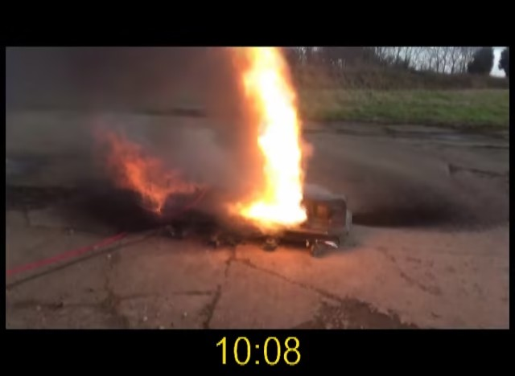
Jet Fire

Slide 20
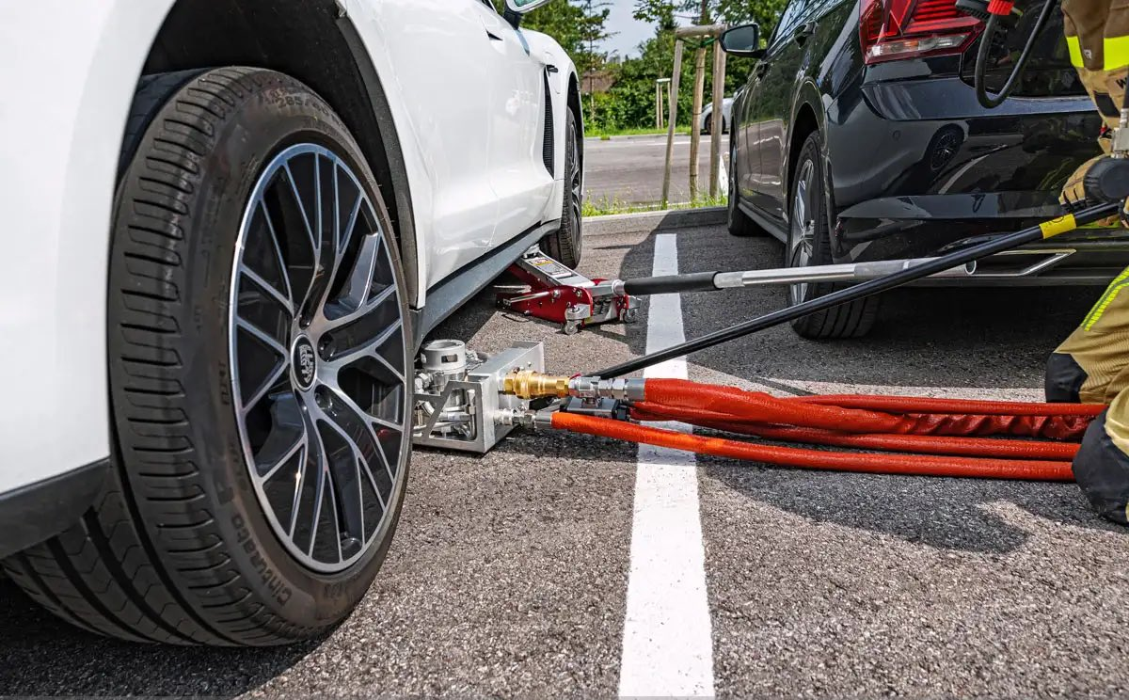
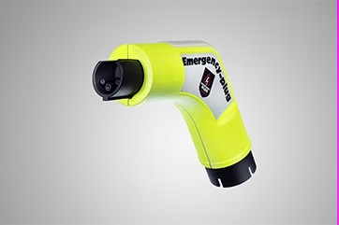
Current Practices
Submerge battery
Gas will rise from water
Enviornment can be toxic and explosive
Don't pierce the battery
You must find the right cell
Hard to set up
Can Create further Runaway
Slow cooling
Time Consuming
Let it burn
Consider location and impacts
Chock wheels on cars
Can move without noise
Emergency plug
Disables vehicle

Slide 21
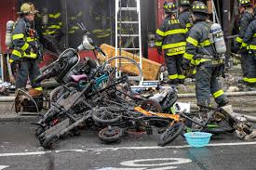
Queens Bike Shop Multiple Rekindles

Slide 22
Water is Still the Best Agent
Water is still your best cooling agent at this time.
Consider how much you need and where to get it from
Hydrants
Canals
Tanker
Pools (extreme cases)
Car fires can take 40k gallons of water in some cases. Depends on how much charge the battery has or energy Stranded.
When the fire in an EV type business is extinguished 1 engine should remain on scene connected to a hydrant. There is no standard on how long but until the batteries and secured expect more fire.

Slide 23
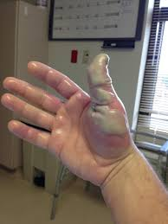
Medical
Burns can be from many routes including inhalation and absorption. Exposed patients should be evaluated and transported.
Again, PPE should be worn, avoid any contact with this gas. Report if you are not feeling well. Early treatment is key.
Many Gasses including
Hydrogen Flouride
CO
CO2
LiPF6 Lithium Hexa-Fluoro-Phosphate
Various other Toxic and Flamable Gas

Slide 24
Greatest Challenges
Any High-Rise
Downtown bike shops could easily spread to exposures
Underpasses (Heat)
Bridges
Parking Garages (Lucky Street)
Charging stations.
Types of Chargers: class 1, Class 2
Turn off the breaker before extinguishing. These are High Voltage
Is it a content fire with a lithium-ion battery or a lithium-ion battery fire.

Slide 25
Controlled video
https://youtu.be/Axlrx3qoIic

Slide 26
Open Discussion
Remember everything in this powerpoint is new and an ongoing process of learning a new type of fire management and fuel source. As we learn more and evolve this information is expected to change. Hopefully you take this as a preliminary knowledge to EV vehicles and lithium batteries. This info comes from
NIST
UL
ATF
FIRE ENGINEERING

